Slide 1
HDL Support
MSc Project - RVFPGA
Dr Tiantai Deng
Lecturer in Electronics and Digital System
t.deng@sheffield.ac.uk
07746660187

Slide 2
Content
Basic Syntax for Verilog HDL & Logic Modelling using Verilog HDL
Simulation using a Testbench
Building Blocks and Ips
Design Choices, Critical Path Mitigation
Evaluation

Slide 3
Basic Syntax for Verilog HDL

Slide 4
Design hierarchy
Module - a collection of statements with a defined interface
In VHDL entity defines the interface
architecture the contents
Component declares a black box (module interface so it can be instantiated)
Instantiation - create one or more instances of a sub module within another module
Libraries – VHDL supports packages which are a collection of modules, types and constants as does system-Verilog.

Slide 5
What’s a Module
Module Name
Port list with declarations of ports
Parameters to allow customisation (optional)
Declaration of local wires/signals/variables
Instantiation of lower level modules
Behavioural statements in blocks
Data flow continuous assignments
Tasks and functions (typically for simulation)

Slide 6
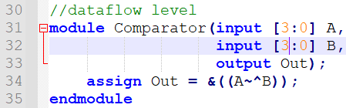
Port Declarations
These are its interface to the next level up / outside world (top)
Have direction input, output, inout
Can be single bit or bit vectors, etc
Got to avoid: don’t use inout just because you want to read a value that should be an output eg the count value of a counter’ create a local signal/wire for internal use and assign from it to create the output.
Example of module declaration

Slide 7
Assignment statements
Z <= A + B; //non-blocking assignment (within process)
Z = A + B; //blocking assignment (within process)
Z <= (sel)? A : B; //conditional assignment (within process)
assign Z = A + B; //standalone continuous assignment (non-blocking)
NOTE: There is no statement like assign Z <= A+B (syntax quirk)
Comments
Just like what we do in C/C++!
//
/* */
Always remember to comment your code while you do the design! Or you wouldn’t know your design after a week!

Slide 8
Modules & ports
VERILOG
VHDL
library IEEE;
use IEEE.STD_LOGIC_1164.ALL;
module test (
output E,
input A,B,C
entity test is port (
A,B,C : in
);
assign E = (A & B) | C;
Endmodule
STD_LOGIC;
: out STD_LOGIC
E
);
end test;
architecture beh of test is
begin
E <= (A and B) or C;
end beh;
input/output can be either be a net (wire) or REG
inout is always a net.

Slide 9
Combinational & Sequential Logic

Slide 10
Combinatorial vs Sequential
Combinatorial:
AND, OR, NOT, XOR, NAND, etc….
DOESN’T STORE ‘state’ and doesn’t need CLOCKING
Sequential:
DFF, registers, memories
Changes ‘state’ on an edge of a CLOCK
Stores / retains data over time

Slide 11
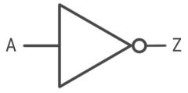
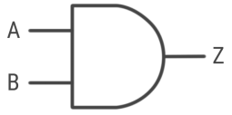
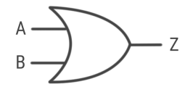
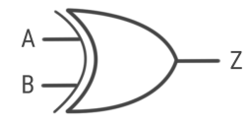
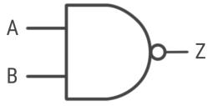
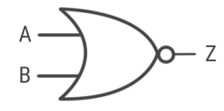
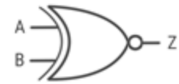
Bit-wise operations
Operator | Verilog assign | Structural Verilog | VHDL | Gate Symbol
NOT | Z = ~ A | not (Z,A) | Z <= not A
AND | Z = A & B | and (Z,A,B) | Z <= A and B
OR (inclusive) | Z = A | B | or (Z,A,B) | Z <= A or B
XOR (exclusive) | Z = A ^ B | xor (Z,A,B) | Z <= A xor B
NAND | Z = ~ A & B | nand (Z,A,B) | Z <= A nand B
NOR | Z = ~ A | B | nor (Z,A,B) | Z <= A nor B
XNOR | Z = ~ A ^ B | xnor (Z,A,B) | Z <= A xnor B

Slide 12
Modelling electrical rules of logic
Verilog “wire”
VHDL “std_logic”
logic 0 (low)
logic 1 (high) high impedance
unknown/impossible
– don’t care
U un-initialised
L H weak low or high
W weak indeterminate
0
1
Z X
0
1
Z X
logic 0 (low)
logic 1 (high) high impedance
unknown/impossible

Slide 13
Logical & Relational Operators
Operator | Verilog | VHDL | Example (Verilog)
NOT | ! | not | busy = !ready;
AND | && | and | congestion = traffic && slowMoving;
OR | || | or | crossRoad = redLight || !traffic;
CONDITIONAL | ? : | when else | hexValue = (ascii>64) ? ascii-’A’ : ascii-’0’;
EQUALITY | == | = | Xmas = (dayOfYear==360);
INEQUALITY | != | /= | counting = (countValue != maxValue);
GREATER THAN | > | >
GREATER OR EQUAL | >= | >=
LESS THAN | < | <
LESS OR EQUAL | <= | <=
NOTE: <= is also SIGNAL assignment operator in VHDL

Slide 14
Arithmetic Operators
Operator | Verilog | VHDL | Example (Verilog)
UNARY NEGATION | - | - | Z = -A
ADDITION | + | + | Z = A + B
SUBTRACTION | - | - | Z = A - B
MULTIPLICATION | * | * | Z = A * B
DIVISION | / | / | Z = A / B
MODULUS | % | mod rem | Z = A % B
LOGICAL SHIFT | << >> | sll srl | Z = A << 3
ARITH SHIFT | <<< >>> | sla sra | Z = sA >> 7
EXPONENTIATION | ** (since 2001) | ** | Z = 2 ** N
ABSOLUTE VALUE |  | abs | Z = (A<0) ? –A : A;

Slide 15
Basic Types
VHDL
boolean
std_logic
std_logic_vector
integer / unsigned / signed
….
System Verilog
bit
byte
short int
int
long int
bit[7:0] abyte
8-bit signed
TWO STATE
0 or 1
16-bit signed 32-bit signed 64-bit signed
logic (or reg)
integer
logic[7:0] abyte 32-bit signed
FOUR STATE 0 1 X Z
Verilog
wire
reg
NOTE: reg means simulator may remember its value. It dosnt mean define a REGISTER despite its name!
time
shortreal
real / realtime
64-bit time aka float aka double

Slide 16
Verilog “REG” !!Don’t get confused!!
In Verilog reg means a declaration of a variable that may potentially hold a value.
This is in contrast to wire which canot hold a value.
reg on its own does not create a digital register. You’d need to use
always @ posedge(clk) value<=whatever; to do that.
It is similar to int or real just declares a bit type
The good news is in systemVerilog they both simply become logic
there is no longer any need to distinguish between reg and wire.
But not so good. When you lose the control over your program, your code maybe hard to crack.

Slide 17
Other Types
VHDL, Verilog and SystemVerilog also have:
Vectors - multiple bits
Integer - for integer arithmetic
Real
Time
Arrays
for floating point arithmetic
exclusively used in simulation
single or multidimensional
Strings - great for test benches / debugging

Slide 18
Busses
Collection of individual signals or n-bit signals
Easy to refer to by name
Make from various individual signals or parts of other buses
Extract individual bit or bits
HDLs make it easy to do all this….

Slide 19
Vectors (Collections of bits)
Bit strings / bit arrays / logic vectors
VERILOG: reg sum[15:0], carry;
VHDL:
signal sum: std_logic_vector(15 downto 0);
signal carry : std_logic;
Why [big:small] or “downto”
Because we humans like to see the MSB at the left hand side.
You can also have arrays of bit strings too…example 4 bytes:
VERILOG: reg block[3:0][7:0];
VHDL: signal block : array (0 to 3) of std_logic_vector(7 downto 0);

Slide 20
Defining Literals
VERILOG: reg [7:0] poly = 8’h1f; // 8 hexadecimal bits
or use ‘d’ decimal, ‘h’ hex, ‘o’ octal, ‘b’ binary
You can use underscore to make more readable eg 32’h1234_c0de
VHDL: signal poly : std_logic_vector(15 downto 0) := X”2c1f”;
For bit strings use double quotes and single bits single quotes
Use X for hexadecimal, “0101” automatically binary string, unquoted is decimal
‘1’ or ‘0’ for single bit (std_logic)
You’ll see plenty more example of this in the lab sessions.

Slide 21
Collection Operators
Operator | Verilog | VHDL | Example (Verilog)
PRIORITY parenthesis | ( ) | ( ) | (A+B)*(C+D)
BIT-SELECT | [ ] | ( ) | signbit = A[31];
PART-SELECT | [ : ] | ( to ) ( downto ) | msb = A[15:8];
CONCATENATION | { } | & | byteswap = { A[7:0], A[15:8] };
Operations we commonly used in Verilog, there are other operations in Verilog, which doesn’t use a lot. We can learn how to use those while encountering one.

Slide 22
Structural, Data flow & Behavioural Models

Slide 23
Modelling of Logic
Combinatorial logic
Boolean expressions
AND, OR, NOT, XOR gates etc…
Sequential logic
Flip-flops
Registers
Hierarchical Design
components
abstraction
design reuse
Arithmetic Logic Unit (ALU)
Arithmetic
Adder
(16bit)
Full Adder

Slide 24
Verilog Modules
The basic building block in Verilog is called a module. A digital system can be described in an HDL by a set of these modules / entities.
Port declarations detail the interface of a module to other modules or the outside world.
A
F
B
module eg1 (A, B, F);
…
…
…
endmodule
The module body describes the function of the model and the relationship between the ports.

Slide 25
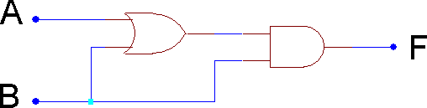
Structural Description - Verilog
The structure of a circuit can be described in Verilog using predefined gate primitives. These include not, and, nand, or, nor, xor, xnor.
C
g1
g2
Example
Text after // is interpreted as a comment. Keywords are in bold.
module example1 (output F, input A, B); // module name and ports
wire C; // declare internal connection
or g1(C, A, B); // or gate with optional name g1
and g2(F, C, B); // and gate with optional name g2
endmodule // gate outputs come first in list

Slide 26
Data flow Description - Verilog
A behavioural Verilog model can be used to describe the functionality of a circuit, independently of a chosen technology.
Logic expressions can be described behaviourally in Verilog using predefined logical operators:
Bitwise NOT
& Bitwise AND
| Bitwise OR
^ Bitwise XOR
^ Bitwise XNOR
module example2 (output F, input A, B);
assign F = (A | B) & B; // continuous assignment
endmodule
Example

Slide 27
Behavioral description
Processes
Behavioural description declared with keyword always, followed by an optional control expression(sensitivity list) and a begin ... end block of procedural assignment statement.
Continuous assignment (assign)
Procedural assignment (non blocking <= (concurrent) or blocking = (sequential)
You can have as many process blocks in an architecture as you wish but any signal/output should only be defined in ONCE.
VERILOG
module decoder_2x4_df_beh(
output [0:3] D,
input A,B, enable
);
always @ (A, B, enable) begin
D[0] <= !((!A) & (!B) & (!enable));
D[1] <= !((!A) & B & (!enable));
D[2] <= !(A & (!B) & (!enable));
D[3] <= !(A & B & (!enable));
end;
endmodule

Slide 28
Procedural if…then…else…elsif…endif
always @ … // verilog begin
if ( condition ) single_statement;
process (…) -- VHDL begin
if condition then
multiple_statements;
end if;
if (condition ) begin multiple_statements; multiple_statements;
end else begin multiple_statements; multiple_statements;
end
if condition then
multiple_statements;
else
multiple_statements;
end if;
if (condition 1 )
single_statement;
else if (condition 2 ) begin multiple_statements; multiple_statements;
end else
single_statement;
end
if condition1 then
multiple_statements;
elsif condition2 then
multiple_statements;
else
multiple_statements;
end if;
end process;
This form of cascaded “if”
is a priority encoder

Slide 29
Procedural case statement
process (All) -- vhdl
case selector is
when 0 => multiple_statements; when 1 => multiple_statements; when 2 to 5 => multiple_statements; when 6|8|10 => multiple_statements;
when label_whatever => statemements;
when others => multiple_statements;
end case;
// if you don’t have any statement for
// an already completed case then
// when others => null; should be used
// works great with enum types
always @ (*) // verilog
case ( selector )
: single_statement;
: begin
multiple_statements; multiple_statements;
end
2: single_statement;
labelWhatever: single_statement;
Case can be more readable
than long cascade of ‘if’s.
Also doesn’t imply priority so arguably often more appropriate description
Great with enumerated types for describing state machines
Ensure case statements are fully complete otherwise infers latches
// can use formatted numbers
// with wildcards too
4’b001?: single_statement;
default: single_statement;
endcase

Slide 30
Defining Constants
VHDL
•
•
•
constant correct_answer : integer range 0 to 7 := 3;
constant space_char : std_logic_vector(7 downto 0) := X”20”;
type atable is array (0 to 255) of std_logic_vector(7 downto 0) :=
{ X”01”, X”23, X”46”, ….. }
Verilog
`define SOME_CONSANT_MACRO 1
# ( parameter WIDTH = 5 )
localparam SOME_CONSTANT_LOCAL = 2; // within module body
// normally at near start of file
// within module declaration

Slide 31
Using submodules
Called ‘Instantiation’
Gives usage a unique name in the hierarchy
Connects the modules ports to signals within parent module
Ports can either be connected by name explicitly or in order of declaration
All inputs must be connected, outputs can be left open / unconnected
Bit vector port widths MUST match
Verilog Gotcha: avoid giving a module/instance/port the SAME name

Slide 32
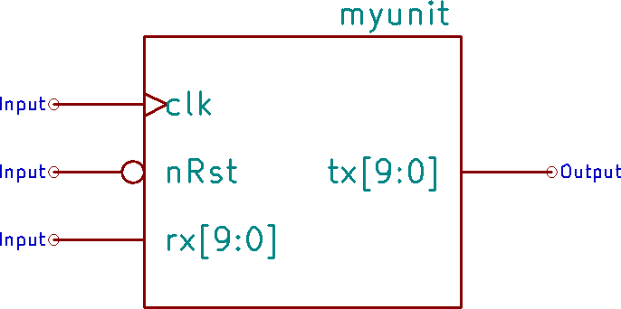
Instantce
VHDL
Your own module
VERILOG
entity top is
port (
module top( input clk,
input rst_n,
input enable, input [9:0] data_rx_1,
input [9:0] data_rx_2,
output [9:0] data_tx
);
wire [9:0] tx1, [9:0] tx2;
myunit unit_idle (clk,rst_n,data_rx_1, tx1); myunit unit_active (.nRst(rst_n), .clk(clk),
.rx(data_rx_2), .tx(tx2) );
assign data_tx = (enable) ? tx2 : tx1;
endmodule
clk, rst_n, enable : in
std_logic;
data_rx_1,data_rx_2 : in std_logic_vector(9 downto 0); data_rx : out std_logic_vector(9 downto 0)
architecture beh of top is component myunit is
port (
clk, nRst : in std_logic;
rx : in std_logic_vector(9 downto 0); tx : out std_logic_vector(9 downto 0)
end component;
signal tx1, tx2 : std_logic_vector(9 downto 0);
begin
unit_idle: myunit port map (clk, rst_n, data_rx_1, tx1); unit_active: myunit port map (nRst=>rst_n, clk=>clk,
);
end top;
);
data_rx <= tx2 when (enable=‘1’) else tx1;
end beh;
rx=>data_rx_2, tx=>tx2);

Slide 33
Parameterization
-- vhdl has generic
entity ram
generic ( DATA_WIDTH : positive := 8; ADDR_WIDTH : positive :=7 );
port (
clk : in std_logic;
address: in std_logic_vector(ADDR_WIDTH-1 downto 0); dataIn : in std_logic_vector(DATA_WIDTH-1 downto 0); dataOut : out std_logic_vector(DATA_WIDTH-1 downto 0); wr : in std_logic )
end ram;
-- example usage
ram_inst: ram
generic map ( data_width=>16, addr_width=>8)
port map ( clk, address, din, dout, wr);
// parameter available since Verilog-2001
module ram(clk,address,dataIn,dataOut,wr);
parameter DATA_WIDTH = 8; parameter ADDR_WIDTH= 7; input clk;
input [ADDR_WIDTH-1:0] address; input [DATA_WIDTH-1:0] dataIn; output [DATA_WIDTH-1:0] dataOut;
…
endmodule
// example usage
ram_inst #(.DATA_WIDTH(16), .ADDR_WIDTH(8) )
ram(clk,address,din,dout,wr);

Slide 34
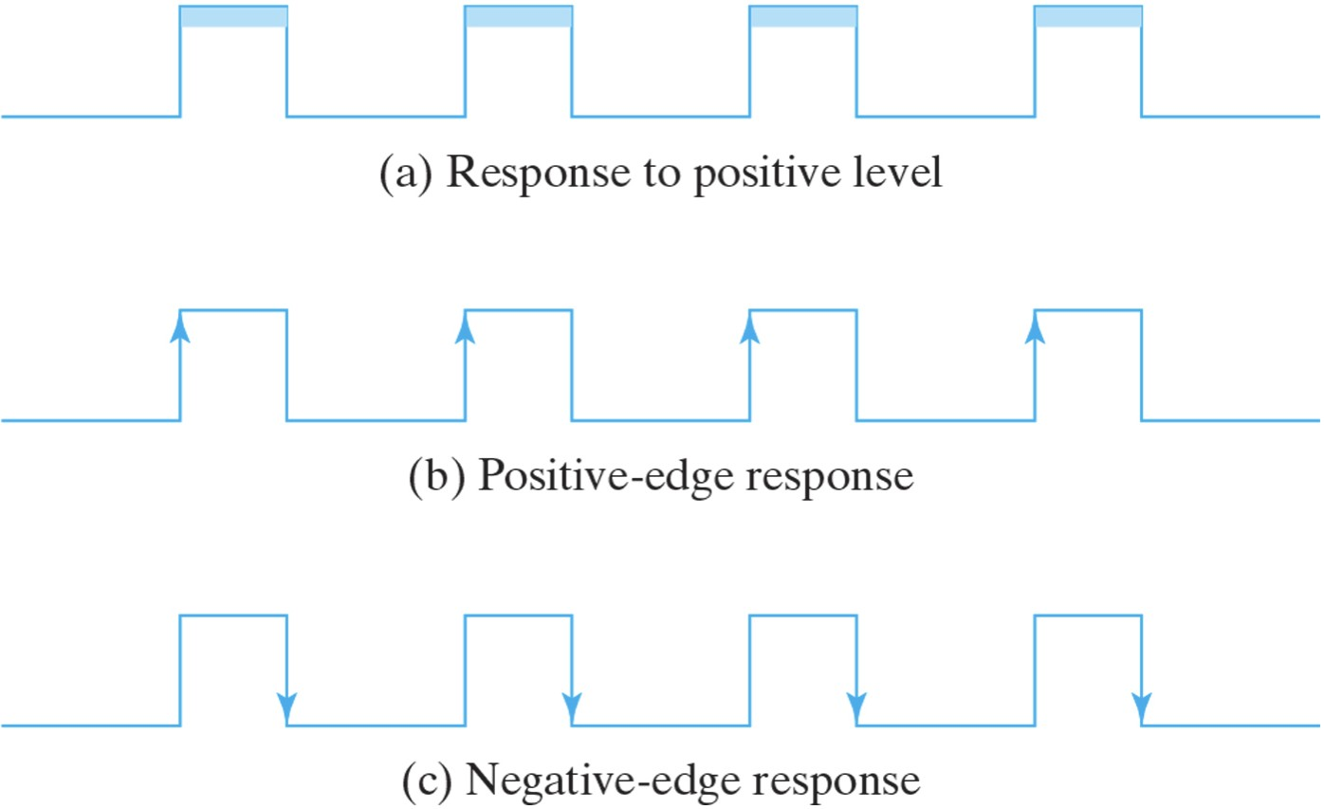
Inferring storage elements
This is sequential logic so we define which clock edge it should act upon. With the exception of special “DDR” I/O cells we are inferring flip-flops which can only act on one edge.
VERILOG:
always @ (posedge someclock)
// always @ (negedge someclock)
VHDL:
process (someclk) begin
if rising_edge() then …
-- if falling_edge() then …
A little question: Why DDR is Double Rate?
Different Response

Slide 35
Registers / DFFs
// Verilog
always @ (posedge(clk)) begin if (load) begin
Q<=D;
end end
D
D Q
CE C
Q[0]
LOAD
CLK | LOAD | D | Q
0 | any | any | Same
1 | any | any | Same
_/--- | 0 | any | Same
_/--- | 1 | 0/1 | D
CLK
-- VHDL
process (clk) begin
if rising_edge(clk) then
if load=‘1’ then
Q<=D;
end if; end if;
end process;
C = clock, CE = clock enable
This is an fpga ‘thing’ due to the global
nature of the clock network

Slide 36
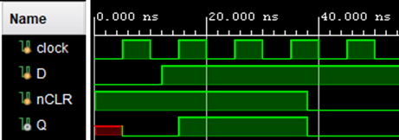
Asynchronous set/clear DFF
// Verilog
module dffr(output reg Q, input D, nCLR, clk);
always @ (negedge nCLR or posedge clk)
begin
if (!nCLR) Q <= 1'b0; else Q <= D;
end endmodule
Note the always and process sensitivity list
differences. It’s all too easy to get wrong!
Generally the use of async is deprecated by FPGA manufacturers.
entity dffr is -- VHDL
port( Q : out std_logic; D,nCLR,clk : in std_logic );
end dffr;
architecture beh of dffr is begin
process (clk, nCLR) begin
if nCLR = ‘0’ then
Q <= '0';
elsif rising_edge(clk) then
Q <= D;
Waveform of module dffr
end if;
end process; end beh;

Slide 37
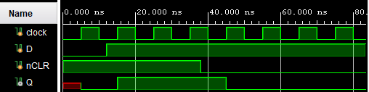
Synchronous set/clear DFF
// Verilog
module dffc(output reg Q, input D, nCLR, clk);
always @ (posedge clk)
begin
if (!nCLR) Q <= 1'b0; else Q <= D;
end endmodule
You’ll need to compare this with the async version on the previous slide to spot the differences.
They are subtle which is often a cause of design errors.
entity dffc is -- VHDL
port( Q : out std_logic; D,nCLR,clk : in std_logic );
end dffc;
architecture beh of dffc is begin
process (clk) begin
if rising_edge(clk) then
if nCLR = ‘0’ then
Q <= '0’;
else
Q <= D;
end if;
Waveform of module dffc
end if;
end process; end beh;

Slide 38
Simulation using a Testbench

Slide 39



Test benches / test fixtures
Tasks
Declare signals/variable to be used for test
Instantiate unit under test
Define clock(s) if any
Generate stimulus pattern (inputs to UUT)
Validate (compare output of UUT with expected values)
Report results
Testbench
Input stimulus
Define clocks
Unit under test (UUT)
Validate
output
Testbench executed by simulator

Slide 40
Scope of testing
Module
It is most expedient to test individual modules against their expected behaviour
Its is usual to have one or more testbench per module in your design
Sub-System
Often a collection of modules can be tested together as a sub-system
Typically for debugging the design and to verify the required performance
Whole System
Such simulations can be very slow to execute so normally reserved for ASIC flows –
for an FPGA its quicker to simply program the real device

Slide 41
Level of testing
Behavioural
Tests if the register transfer level statements are correct on a cycle per cycle basis
Doesn’t have any path / gate timing information
Would ‘pass-the-test’ even with an absurdly fast clock
Very quick to simulate
Post implementation
Incorporates (back annotates) path & gate timing information to accurately model
the expected performance of the device
Models are relatively crude but effective
Two timing corners best case and worst case
Confirms setup and hold times are not violated
Needs information on external circuit capacitive loading
User constraint ‘guestimates’ can lead to simulation and device mismatches

Slide 42

Self-checking test benches
Testbench
Input stimulus
Generate a comprehensive set of test cases
Compare the output of the UUT against either an alternative design or simulation model
The reference design doesn’t need to meet timing/area constraints as is only a simulation so often can be simply coded
Finally generate a report to indicate any test failures
Known good design / sim model
Unit under
test (UUT)
Compare outputs

Slide 43
Test coverage
Ideally should test every decision / path through a design for correctness - often too time consuming
Simulators have ‘force’ commands to allow system to be put into specific state before/during a test this can dramatically reduce testing time.
Generating an economic set of test vectors for ASIC/FPGA testing is a job in its own right (verification engineer)

Slide 44
Modelling other parts of system
For a system which needs to respond to external hardware testing often requires this is modelled too.
For example you may need to model an SPI or I2C sensor device and an actuator controlled by the UUT to verify that it works correctly.
The HDL can do this too – you can write your own models for parts of a system (not synthesisable) which will simulate some missing hardware.
This allows the use of the super-set of the language that can be simulated as well as synthesised.

Slide 45
Simple Testbench

Slide 46
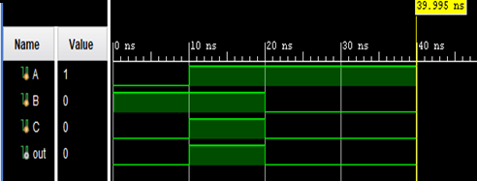
Your First Verilog Test Fixture
`timescale 1ns / 1ps
“#” time unit / simulation resolution
module simple( output q, input a,b,c
);
wire e;
and a1(e,a,b);
or o1(q,e,c);
endmodule
module tb_simple( );
Module with no ports is a testbench
reg A,B,C;
wire out;
Declare signals for input as reg
and outputs as wire
simple uut(out, A,B,C);
Instantiate unit under test
initial begin
A=1'b0; B=1'b1; C=1'b0; #10 A=1'b1; B=1'b1; C=1'b1; #10 A=1'b1; B=1'b0; C=1'b0;
#20 $finish;
end
‘initial’ block containing the desired stimulus and $finish at its end
endmodule

Slide 47
Test bench outline
VHDL
library IEEE;
use IEEE.STD_LOGIC_1164.ALL;
entity tb_whatever is end tb_whatever;
architecture Behavioral of tb_whatever is
…
begin
…
end Behavioral;
Verilog
`timescale 1ns / 1ps
module tb_whatever ();
…
endmodule

Slide 48
Unit Under Test (UUT)
library IEEE;
use IEEE.STD_LOGIC_1164.ALL;
entity tb_whatever is
end tb_whatever;
architecture Behavioral of tb_whatever is
component test_module_name
port ( list_of_out_ports : out std_logic;
list_of_in_ports : in std_logic); end component;
signal list_of_ins_and_outs : std_logic;
`timescale 1ns / 1ps
module tb_whatever (); reg list_of_inputs;
wire list_of_outputs;
test_module_name uut(list_of_ins_and_outs)
…
endmodule
begin
uut: test_module_name
port map (list_of_ins_and_outs);
…
end Behavioral;

Slide 49
Clock Stimulus
library IEEE;
use IEEE.STD_LOGIC_1164.ALL;
entity tb_whatever is end tb_whatever;
architecture Behavioral of tb_whatever is
component test_module_name
port ( … );
end component;
signal clock : std_logic := '0';
signal list_of_ins_and_outs : std_logic;
begin
uut: test_module_name
port map ( clock, list_of_ins_and_outs);
clock <= !clock after 5 ns; -- half clock period
…
end Behavioral;
`timescale 1ns / 1ps
module tb_whatever (); reg clock=0;
reg list_of_inputs;
wire list_of_outputs;
test_module_name uut(clock, list_of_ins_and_outs)
always #5 clock=!clock; // #5=half clock period
…
endmodule

Slide 50
library IEEE;
use IEEE.STD_LOGIC_1164.ALL;
entity tb_whatever is
end tb_whatever;
architecture Behavioral of tb_whatever is component test_module_name
port ( clock : in std_logic; list_of_out_ports : out std_logic; list_of_in_ports : in std_logic);
end component;
signal clock : std_logic := '0';
signal list_of_ins_and_outs : std_logic;
begin
uut: test_module_name port map ( clock, list_of_ins_and_outs);
clock <= !clock after 5 ns; -- half clock period
process begin some_inputs=their_intial_values; wait for 10 ns; some_inputs=next_value;
wait for 10 ns; some_inputs=another_value; wait for 100 ns;
wait;
end process;
end Behavioral;
Test pattern generation
`timescale 1ns / 1ps
module tb_whatever (); reg clock=0;
reg list_of_inputs;
wire list_of_outputs;
test_module_name uut(clock, list_of_ins_and_outs) always #5 clock=!clock; // #5=half clock period initial begin
some_inputs=their_intial_values;
#10 some_inputs=next_value;
#10 some_inputs=another_value;
#100 $finish;
end endmodule

Slide 51
The complete simple TB
library IEEE;
use IEEE.STD_LOGIC_1164.ALL;
entity tb_whatever is
end tb_whatever;
architecture Behavioral of tb_whatever is component test_module_name
port ( clock : in std_logic; list_of_out_ports : out std_logic; list_of_in_ports : in std_logic);
end component;
signal clock : std_logic := '0';
signal list_of_ins_and_outs : std_logic;
begin
uut: test_module_name port map ( clock, list_of_ins_and_outs); clock <= !clock after 5 ns; -- half clock period
process begin some_inputs=their_intial_values; wait for 10 ns; some_inputs=next_value;
wait for 10 ns; some_inputs=another_value; wait for 100 ns;
wait;
end process; end Behavioral;
`timescale 1ns / 1ps
module tb_whatever (); reg clock=0;
reg list_of_inputs;
wire list_of_outputs;
test_module_name uut(clock, list_of_ins_and_outs) always #5 clock=!clock; // #5=half clock period initial begin
some_inputs=their_intial_values;
#10 some_inputs=next_value;
#10 some_inputs=another_value;
#100 $finish;
end endmodule

Slide 52
simulation “how to” guide

Slide 53
Signal & variable declarations
Define signals for all the inputs / outputs to / from the UUT
Define constants typically arrays for your test vectors, keep these in their given format and write a function to manipulate into the format your module needs
Define parameters for clock periods, etc for easy of editing/reading
Ensure the initial state of inputs to the UUT is defined (especially any clocks)
reg some_input=0, another_input=1;
wire list_of_outputs;
reg [7:0]DATA[1:8] = {>>{64'h1234_5678_9abc_def0}};
parameter CLOCK_PERIOD = 10;
reg clk = 0;
always #(CLOCK_PERIOD/2) clk = !clk;

Slide 54
Delays
These can either be event triggered or simply a time delay
To keep the UUT and test bench perfectly in sync it is often desirable to wait specifically for a clock edge in the test bench
For a Verilog testbench the `timespec has to be defined ONCE typically the first line
#10 next_statement wait for 10 ns;
always @rising_edge(clk) wait until rising_edge(clk);

Slide 55
Loops
Unlike synthesis loops can be defined very similar to how you would use them in a conventional programming language i.e. analogous to control flow
Very convenient for say looping over a set of test vectors
Just describe the loop and wait for the appropriate event / clock
integer i;
for (i=0; i<16; i=i+1) // note there is no i++ in Verilog
begin
@(posedge clk);
some_uut_input = SomeFn(some_signal[i]);
while (!output_valid) @(posedge clk);
end

Slide 56
Process blocks
Separating independent tasks using multiple process blocks
Eg stimulus generation, clock generation, testing, other part of system modelling
It is very normal to have several independent loops in a test bench some of which become activated by others using a Boolean variable to periodically model / verify different parts of the system
Eg you may have a process that verifies the value of an output is correct but only when the output_valid signal is asserted.
Embrace multiple process blocks for more readable testbenches

Slide 57
Verilog system tasks
Display text to the console
$display $monitor $strobe $write
Terminate the simulation / task
$finish $stop
Define the formatting and unit for reporting timestamps of events
$timeformat
Read data from a text file as binary or hex into a testbench array
$readmemb, $readmmemh
File I/O at the character/line level (like C programming language)
$fopen, $fseek, $ftell, $fgetc $fgets, $fstrobe $fflush, $ferror $fmonitor $fwrite $fclose

Slide 58
Displaying text
How to display text messages and monitor signals
initial begin
$display("\t\ttime,\tclk,\treset,\tenable,\tcount");
$monitor("%d,\t%b,\t%b,\t%b,\t%d",
$time, clk, reset, enable, count);
end
use std.textio.all;
…
report "Time, clk, reset, enable, count";
…
process -- to get the same as Verilog monitor
variable txt : line;
begin
write(txt, time); write(txt, string'(","));
write(txt, clk); write(txt, string'(","));
write(txt, reset); write(txt, string'(","));
write(txt, enable); write(txt, string'(","));
write(txt, count); write(txt, string'(","));
report "values are " & txt.all;
wait on clk;
end process;
These Verilog system tasks all have same syntax but
operate slightly differently:
$display output immediately
$monitor output every time value(s) change
$strobe output at the end of time step (eg $finish)

Slide 59
Waveform Viewer
Most simulators have a waveform view like a traditional logic analyser
This can be used to delve down into signals in the design hierarchy not connected to the top level – typically just expand the hierarchy and drag the signals to the viewer then rerun simulation
Signals can be grouped, coloured and dividers added to make display more human readable.
The radix (number base) for bit vectors can be set to binary, hex, octal or even ASCII
TopTip: if you use enumerated type for state machines the waveform viewer will automatically display the textual names

Slide 60
Value Change Dump (VCD)
Put your signals and waveforms into a file
Documents switching activity
Required for accurate power modelling
Basic Format
How to invoke
initial begin
$dumpfile ("whatever.vcd");
$dumpvars;
end
There is no equivalent command in VHDL. Either do it from the simulator command window using the “vcd” command
Or use a Verilog test bench
Refer to the user guide for your simulator for further details (eg ModelSim or Xsim)

Slide 61
Generating test vectors
-- vhdl random in testbench
library ieee;
use ieee.math_real.uniform;
use ieee.math_real.floor;
…
process is
variable seed1 : positive := 1234; variable seed2 : positive := 5678; variable x : real;
variable y : integer; begin
for n in 1 to 10 loop uniform(seed1, seed2, x);
y := integer(floor(x * 1024.0));
report "Random number in 0 .. 1023: "
& integer'image(y); end loop;
wait;
end process;
Eg random number generation in a test bench
Verilog has some system functions:
$random $urandom $urandom_range()
VHDL is predictably more wordy!
Alternative is to use LFSR, hash, cipher, …
// Verilog random in testbench
integer seed = 1234, rv;
initial begin
repeat (10) begin
rv = $random(seed) % 31;
$display("%d", rv);
end
end

Slide 62
FSM: Finite State Machine

Slide 63


FSM architecture
It is an abstract machine that can be in exactly one of a finite number of states at any instant in time.
It changes state in response to inputs and current state; typically clocked.
It has an initial (default) state (on reset).
To be useful it requires some definition of output function the form of which defines whether it is a Mealy or Moore machine.
State memory
State
memory
inputs
Transition
Output logic
inputs
Transition
Output
logic
logic
clk
logic
clk
Outputs
Outputs
MEALY MACHINE
MOORE MACHINE

Slide 64
FSM state encoding
The state is encoded as a set of numbers. In Verilog there is no enumerated type so these are declared as parameters (constants). Just number as 1,2,3,4,…. In VHDL use enumerated type without assigning any numerical values.
By default the tools IGNORE the numbers you enter! (unless you set fsm_encoding=“User”).
The tools normally do a very good job assigning the state encoding automatically. An attribute fsm_encoding can be used to override this.
Vivado options are: Auto, One-Hot, Compact, Sequential, Gray, Johnson, User, Speed or None. Just set this attribute on the state variable/signal to define your design intent. For example:
(* fsm_encoding = “one_hot” *) reg [1:0] current_state;

Slide 65
FSM state encoding
(* fsm_encoding = “one_hot” *) reg [1:0] current_state;
Binary: use binary code to represent states
One-hot: There will be a unique “1” in the encoding, which represent the state
Gray: only one bit can be changed in the transition of the states
Johnson: LSB = ~MSB, shift << 1
Compact: Least area mode, automatically pick the most area efficient way
Sequential: Optimize the state transition process
User: Use user’s encoding
Speed: Max performance mode.
None: The compiler will not regard this part of code as FSM
Safe mode: Automatically add default sentence if user doesn’t setup default
Auto: Automatically pick up the most suitable one above
Notes:
B: 00 01 10 11 easy to implement
O-h: 0001 0010 0100 1000 less hardware resources
Gray: 00 01 11 10 but not 00 01 10 11 more stable signal
Johnson: 000 – 001 – 011 – 111- 110 - 100

Slide 66
FSM avoiding problems
Two things to be aware of is that the output from the FSM can contain glitches and if the inputs are not synchronised their transitions can lead to an invalid state being selected.
Both of these can be fixed by registering/synchronising inputs and outputs at the cost of a clock cycle delay. FSM choices such as one-hot or Gray can also help prevent unwanted glitches.
For one-hot the tools automatically generate error-correction logic if multiple
states are ‘hot’ see UG901 Synthesis guide FSM_SAFE_STATE for details.
Typically if you are doing synchronous (clocked) design with a single clock then you wont experience any problems – just take care with off chip inputs & outputs.
Ensure that your initial state is defined on FPGA initialisation and for any external reset signal

Slide 67
FSM Descriptions
State diagram (bubbles, arrows, describe output)
truth tables for next state and output signal
Sometime use Karnaugh Maps but usually state transition table
Timing diagrams (logic analyser view showing a state sequence)
Transitions can be:
event driven (depend on the inputs),
automatic progression (clocked in some sequence)
self-transitions (automatic on next clock)

Slide 68
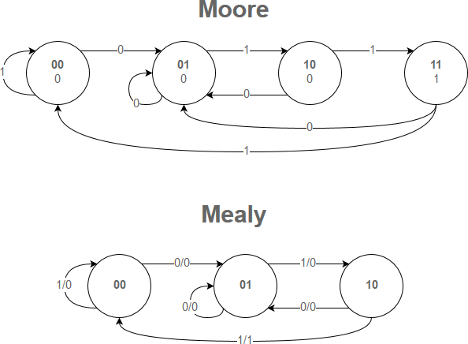
State Diagrams Explained
Circle indicate a state
Transition condition (input)
MOORE
State encoding or name
Line indicates a possible transition
Output value (MOORE)
Both these FSMs detect the input sequence 011
MEALY
Transition Condition “/” Output value
(MEALY)
State encoding or name

Slide 69
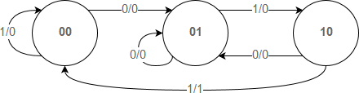
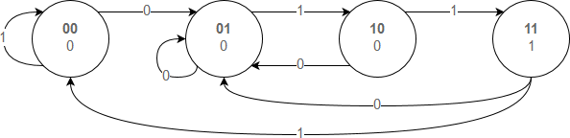
State Transition Table
MEALY
MOORE
Current State | Input | Next State | Output
00 | 0 | 01 | 0
00 | 1 | 00 | 0
01 | 0 | 01 | 0
01 | 1 | 10 | 0
10 | 0 | 01 | 0
10 | 1 | 00 | 1
11 | 0 | X | X
11 | 1 | X | X
Current State | Next State |  | Output
 | Input=0 | Input=1
00 | 01 | 00 | 0
01 | 01 | 10 | 0
10 | 01 | 11 | 0
11 | 01 | 00 | 1

Slide 70
HDL coding strategy to avoid human errors
module ExampleFsm( input clk, nrst, bitin, output reg Q)
// best to use parameter to give states suitable names
parameter ZeroState=0, FirstState=1, SecondState=2, ThirdState=3;
reg [1:0] current_state=0, next_state; // registers for state variable
always @(posedge clk) // sequential state update
if (nrst) current_state <= next_state;
else current_state <= ZeroState;
always @(*) begin // combinatorial transition & output logic next_state <= current_state; // by default stay in same state Q<=0; // set the default case for all outputs
case (current_state) // case statement to define behaviour
Please follow this style of coding until you are very confident with the language - it does make it easier to detect errors.
There are several other ways to describe a FSM – I’ll use some of these in the notes.
There is a sequential block to update the current_state with the next_state.
A combinatorial block for transition and output function
We define the “defaults” for each output and to remain in the current state unless we state otherwise.
ZeroState:
FirstState:
if (bitin==0) next_state <= FirstState;
if (bitin==1) next_state <= SecondState;
SecondState: if (bitin==1) next_state <= ThirdState; ThirdState: begin
Q<=1;
if (bitin==1) next_state <= FirstState;
else next_state <= ZeroState;
end
default: next_state <= ZeroState; // always have default
endcase end endmodule

Slide 71
FSM Examples
It is quickest to learn about FSMs by example so here are several to get you going

Slide 72

Glitch remover
Design Intent is for a noise elimination circuit which removes any pulses, either a zero or a one, which only last one clock cycle.
IN OUT
Outline design:
We’ll start by choosing to design a Moore machine
Assign each state a letter a,b,c,….
Work out what transitions should be for each possible input and construct the ASM chart for all possibilities of each successive input bit.

Slide 73
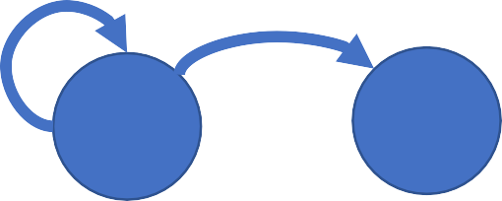
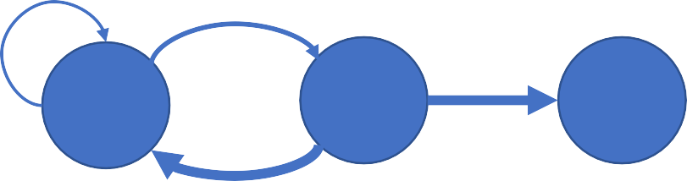
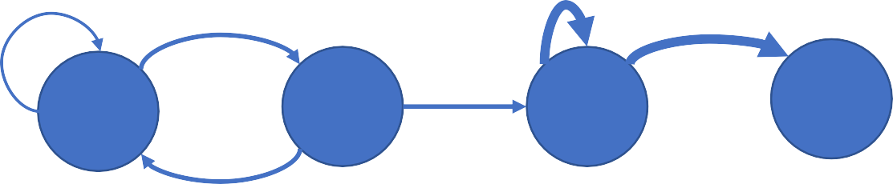
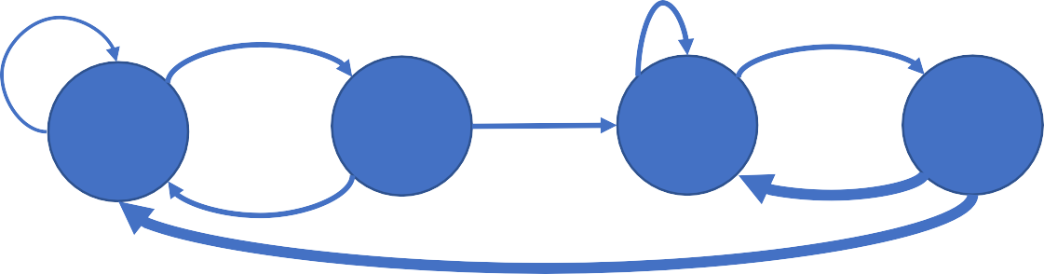
Glitch remover
0
IN 00, 01
1
b
/0
a
/0
0
1
1
IN ...00 …01
a
/0
b
/0
c
/1
0
0
1
0
1
a
/0
b
/0
1
c
/1
d
/1
IN …10 ...11
0
0
1
0
1
b
/0
1
c
/1
d
/1
a
/0
IN ….101 .…111
0
1
0

Slide 74
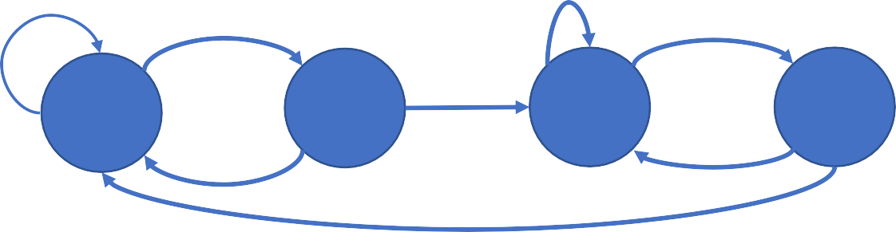
Glitch remover
/* This is an alternative common FSM description to give you an
example: note that the state transitions is the ‘clocked’ process. */
// declarations
module GlitchRemover( output reg out, input in, clk, nrst);
parameter ST_A=0, ST_B=1, ST_C=2, ST_D=3;
reg [1:0] state = ST_A;
// state transitions
always @(posedge clk)
if (nrst==1'b0) state <= ST_A;
else
case (state)
ST_A: if (in==1'b1) state <= ST_B;
ST_B: if (in==1'b1) state <= ST_A; else state <= ST_C;
ST_C: if (in==1'b0) state <= ST_D;
ST_D: if (in==1'b1) state <= ST_B; else state <= ST_A;
default: ; // do nothing
endcase
// output logic
always @ (*)
case (state)
ST_A: out <= 1'b1; ST_B: out <= 1'b0; ST_C: out <= 1'b1; ST_D: out = 1'b1;
endcase endmodule
There are three parts to the Verilog description:
Declarations
State transitions
Output logic
0
1
0
1
b
/0
1
c
/1
d
/1
a
/0
0
1
0

Slide 75
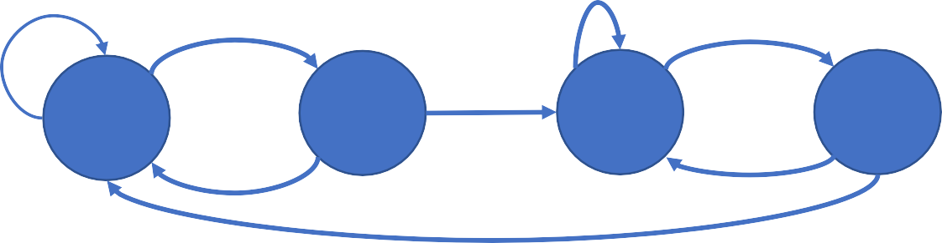
Glitch remover
`timescale 1ns / 1ps // Verilog testbench
module tb_glitchremover();
reg in=0, clk=0, nrst=0;
wire out;
GlitchRemover UUT( out, in, clk, nrst );
We verify it by creating a testbench and simulating in XSIM.
always #5 clk=!clk;
integer i, times[0:7]={>>{5,1,3,3,1,5,1,5}};
initial begin
#15 nrst=1;
for ( i=0; i<8; i=i+1 ) #(10*times[i]) in=!in;
end
endmodule
0 1
0
1
b
/0
1
c
/1
d
/1
a
/0
0
1
0
Exercise: See if there are any logic errors in the FSM code?

Slide 76
Glitch remover
/* This is an alternative common FSM description to give you an
example: note that the state transitions is the ‘clocked’ process. */
// declarations
module GlitchRemover( output reg out, input in, clk, nrst);
parameter ST_A=0, ST_B=1, ST_C=2, ST_D=3;
reg [1:0] state = ST_A;
// state transitions
always @(posedge clk)
if (nrst==1'b0) state <= ST_A;
else
case (state)
ST_A: if (in==1'b1) state <= ST_B;
ST_B: if (in==1'b1) state <= ST_C; else state <= ST_A;
ST_C: if (in==1'b0) state <= ST_D;
ST_D: if (in==1'b1) state <= ST_C; else state <= ST_A;
default: ; // do nothing
endcase
// output logic
always @ (*)
case (state)
ST_A: out <= 1'b0; ST_B: out <= 1'b0; ST_C: out <= 1'b1; ST_D: out <= 1'b1;
endcase endmodule

Slide 77
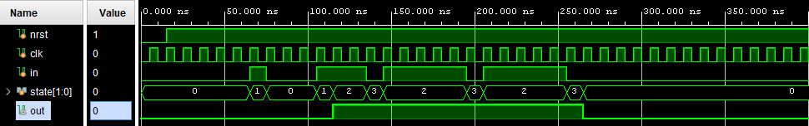
Glitch remover
FSM State transitions.
0 1
0
1
b
/0
1
c
/1
d
/1
a
/0
0
1
0
We verify it by creating a testbench and simulating in XSIM.

Slide 78
Delay generator
Design intent is to detect the rising edge of the trigger then after a N cycles delay of the system clock produce a one cycle pulse on the tick signal. The range of N is 0..1023 cycles (10 bits).
// Create Date: 02.02.2020 13:13:13
// Module Name: DelayGen
// Engineer: T Good
// Target Devices: Any FPGA
// Tool Versions: Vivado 2019.2
// Description: Generate a single cycle tick pulse 1..1024 cycles after trigger
// Revision: 1
module DelayGen
#( parameter DELAY_BITS = 10 )
( input clk,
input trigger,
input [DELAY_BITS-1:0] N,
output reg tick );
N
Delay Gen
tick
trigger
clk

Slide 79
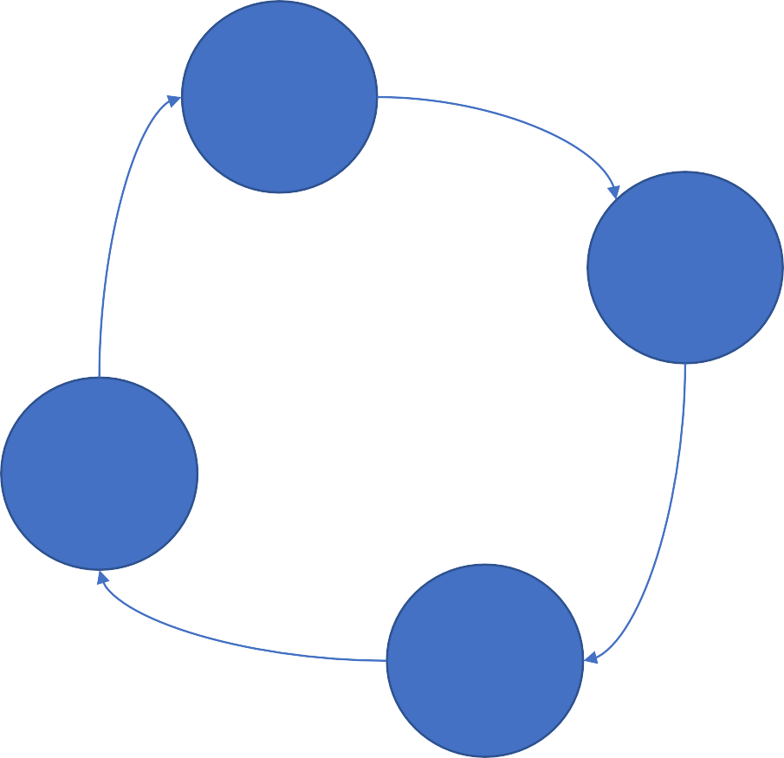





Delay generator
module DelayGen
#( parameter DELAY_BITS = 10 )
( input clk, trigger, [DELAY_BITS-1:0] N, output reg tick );
// declare out counter
reg [DELAY_BITS-1:0] count = {{1'b1}}; // initially 111..111
// declare our FSM states
localparam IDLE=0, COUNTING=1, TIME_OUT=2, WAIT_LOW=3;
reg [1:0] state = IDLE;
always @(posedge clk)
case (state)
IDLE: if (trigger==1'b1) state <= COUNTING; COUNTING: if (count==0)
begin count<={{1'b1}}; state<=TIME_OUT; end else count <= count - 1;
TIME_OUT: if (trigger==1'b0) state <= IDLE;
else state <= WAIT_LOW; WAIT_LOW: if (trigger==1'b0) state <= IDLE; default: state <= IDLE;
endcase
assign tick = (state==TIME_OUT) ? 1'b1 : 1'b0;
endmodule
IDLE 0
COUN TING 0
WAIT
_LOW
0
TIME
_OUT
1
Exercise: Synthesis this and look at report to see what it infers? Hopefully you should see a FSM and a COUNTER.

Slide 80
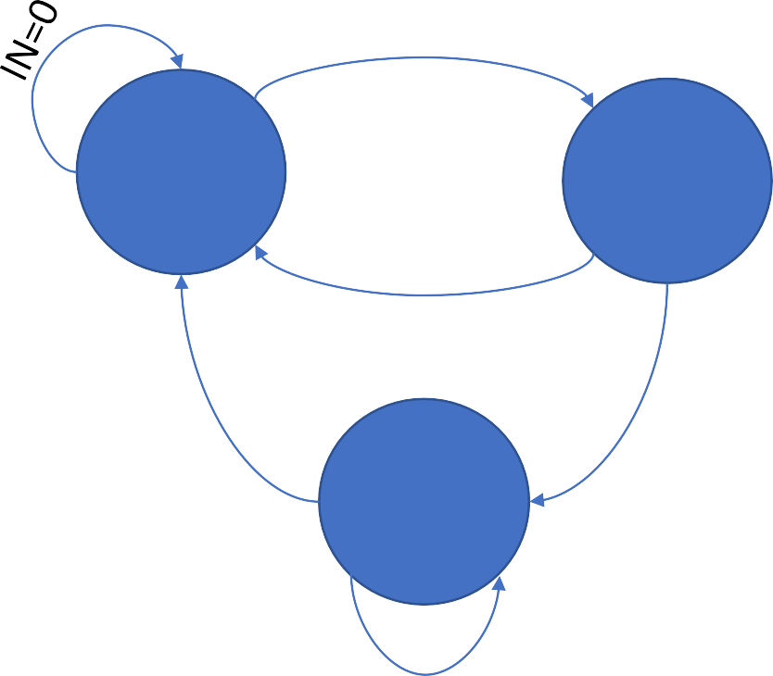
Pulse generator (edge detector)
Design intent is a synchronously clocked module which on each positive edge of the input generates an output lasting one clock cycle.
IN=1
IDLE
out=0
IS_
HIGH
out=1
Edge
IN=0
in
out
Detector
IN=0
IN=1
WAIT
_LOW
out=0
clk
Exercise: Code it in the Vivado
IN=1

Slide 81
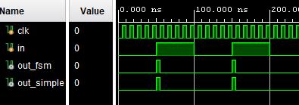
Pulse generator
module EdgeDetectorFsm
( input clk, in, output reg out );
// declare our FSM states
parameter IDLE=0, IS_HIGH=1, WAIT_LOW=2;
reg [1:0] state = IDLE;
always @(posedge clk)
case (state)
IDLE: if (in==1'b1) state <= IS_HIGH; IS_HIGH: if (in==1’b1) state <= WAIT_LOW;
else state <= IDLE; WAIT_LOW: if (in==1'b0) state <= IDLE; default: state <= IDLE;
endcase
always @ (*)
case (state)
IDLE: out <= 1’b0; IS_HIGH: out <= 1’b1; WAIT_LOW: out <= 1’b0;
endcase endmodule
This is an example of overkill to describe such a simple module using a FSM.
For an edge detector it could be described in a few lines.
module EdgeDetectorSimple ( input clk, in, output out );
reg prev = 0;
always @(posedge clk) prev = in;
assign out = in & !prev;
endmodule
Exercise: Synthesis both versions. Are there any difference in the utilization result?

Slide 82

Pulse generator
module EdgeDetectorFsm
( input clk, in, output reg out );
// declare our FSM states
parameter IDLE=0, IS_HIGH=1, WAIT_LOW=2;
reg [1:0] state = IDLE;
always @(posedge clk)
case (state)
IDLE: if (in==1'b1) state <= IS_HIGH; IS_HIGH: if (in==1’b1) state <= WAIT_LOW;
else state <= IDLE; WAIT_LOW: if (in==1'b0) state <= IDLE; default: state <= IDLE;
endcase
always @ (*)
case (state)
IDLE: out <= 1’b0; IS_HIGH: out <= 1’b1; WAIT_LOW: out <= 1’b0;
endcase endmodule
This is an example of overkill to describe such a simple module using a FSM.
For an edge detector it could be described in a few lines.
module EdgeDetectorSimple ( input clk, in, output out );
reg prev = 0;
always @(posedge clk) prev = in;
assign out = in & !prev;
endmodule
Exercise: Synthesis both versions. Are there any difference in the utilization result?

Slide 83
Building Blocks & IPs
Developing useful building blocks for digital design

Slide 84




Lego Parts for Lego Toy, Building Blocks for Hardware
Logic building blocks described in different ways.
Building blocks are concepts such counters, shift
register, multiplexers, synchronisers, etc…
The ways may be symbolic (gates, circuits) or mathematical (Boolean, truth tables) or linguistic (Verilog, vhdl)

Slide 85
Registers / DFFs
// Verilog
always @ (posedge(clk)) begin if (load) begin
Q<=D;
end end
D[0]
D Q
CE C
Q[0]
CLK | LOAD | D | Q
0 | any | any | Same
1 | any | any | Same
_/--- | 0 | any | Same
_/--- | 1 | 0/1 | D
D[1]
D Q
CE
C
Q[1]
-- VHDL
process (clk) begin
if rising_edge(clk) then
if load=‘1’ then
Q<=D;
end if; end if;
end process;
D[15]
D Q
CE
C
Q[15]
CLK
C = clock, CE = clock enable
This is an fpga ‘thing’ due to the global
nature of the clock network
LOAD

Slide 86
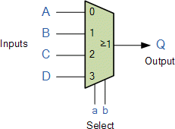
Multiplexer
// Verilog
always @ (*) begin case (select)
2'b00: Q = A;
2'b01: Q = B;
2'b10: Q = C;
2'b11: Q = D;
endcase
end
S[1] | S[0] | A,B,C,D | Q
0 | 0 | 0/1 | A
0 | 1 | 0/1 | B
1 | 0 | 0/1 | C
1 | 1 | 0/1 | D
-- VHDL
process (All) begin
case (select) is
when “00” => Q <= A; when “01” => Q <= B; when “10” => Q <= C; when “11” => Q <= D;
when others => null;
end case; end process;
S[1] S[0]
select
Remember: ensure cases are complete
otherwise you’ll end up inferring a latch
Exercise:
Try describing a mux using conditional continuous assignment statement.
Write a N-way mux which using a bit-vector for the input

Slide 87
Encoders / Decoders
In the olden days of discrete logic chips we could buy devices such as 3-to-8 line decoders (74LS138) and 8-bit priority encoders (CD4532B) so these concepts are still thought of as fundamentals.
In HDL terms these can all be done with a simple case statement or lookup table or ROM to define their behaviour. The tools handle the detail for us automatically.
We just need to define output as some function of the input. Typically indexing into an array or a case statement is all we need.
Follow the example of a Priority Encoder or ROM or SevenSeg lab1&2.

Slide 88
Shift Register
parameter shift = 10; // verilog
reg [shift-1:0] SR = {shift{1'b0}};
Serial in and serial out (could be multibit)
Values appear with a shift-length delay in clock cycles (eg 10)
always @(posedge clk)
SR <= {serial_in, SR[shift-1:1]};
assign serial_out = SR[0];
serial_in serial_out
Shift register (storage)
generic ( width : positive := 10 ) -- vhdl
signal SR : std_logic_vector(width-1 downto 0);
process (clk) begin
if rising_edge(clk) then
SR <= serial_in & SR(width-1 downto 1);
end if;
end process;
serial_out <= SR(0);
serial_in
serial_out
clk

Slide 89
Parallel to serial – This is similar to Lab 4 TxD
Shift register: parallel in and serial out with load
Clock cycle | Load | Internal SR value | Serial out
0 | 0 | 00000000 | 0
1 | 0 | 00000000 | 0
2 | 1 | 10010011 |  | 1
3 | 0 | 01001001 |  | 1
4 | 0 | 00100100 |  | 0
5 | 0 | 00010010 |  | 0
6 | 0 | 00001001 |  | 1
7 | 0 | 00000100 |  | 0
8 | 0 | 00000010 |  | 0
9 | 0 | 00000001 |  | 1
10+ | 0 | 00000000 | 0
parameter piso_shift = 8;
reg [piso_shift-2:0] SR
= {piso_shift-1{1'b0}};
reg serial_out = 1'b0;
always @(posedge clk)
if (load) begin
SR<= par_in [piso_shift-1:1];
serial_out <= SR [0];
end
else begin
SR <= {1'b0, SR[piso_shift-2:1]}; serial_out <= SR[0];
end
load
Shift register
par_in 10010011
serial_out
clk

Slide 90
Serial to Parallel
parameter shift = 10; // verilog
reg [shift-1:0] SR = {shift{1'b0}};
This is simplest case, normally would have extra control for framing and handshaking
always @(posedge clk)
SR <= {serial_in, SR[shift-1:1]};
assign parallel_out = SR;
Shift
register
generic ( width : positive:= 10 ) -- vhdl
signal SR : std_logic_vector(width-1 downto 0);
process (clk) begin
if rising_edge(clk) then
SR <= serial_in & SR(width-1 downto 1);
end if;
end process; parallel_out <= SR;
serial_in
parallel_out
clk

Slide 91
Simple Counter
Count from zero upwards wrapping around at 2^{N} -1 for example 8-bits
Every clock cycle the counter increases by one:
0,1,2,3…….253,254,255,0,1,2,3….
Always initialise a simple counter otherwise simulation will fail.
// Verilog
reg [7:0] count = 0;
always @ (posedge clk) count <= count +1;
-- vhdl
signal count : std_logic_vector(7 downto 0)
:= ( others => ’0’ );
process (clk) begin
if rising_edge(clk) then
count<=count+1;
end if; end process;
Simple Counter
Exercise:
Create a counter that counts from 15 to 0 (i.e. backwards), and automatically back to 15 to count endlessly.
count
clk

Slide 92
Counter with reset
module modNctr
# (parameter N = 10, WIDTH=4)
( input clk, nrst,
output reg [WIDTH-1:0] count = 0 );
always @ (posedge clk) begin if (!nrst || (count==N-1))
count = 0;
else
count <= count +1;
end endmodule
Adding a synchronous reset and wrapping around at some predefined value
In VHDL we can use ranged integer to give a concise definition, std_logic_vector or unsigned() can be used too.
As an alternative can also write
count<=(count+1) mod N;
constant N : integer := 10;
signal count : integer range 0 to N-1 := 0;
process(clk) begin
if rising_edge(clk) then
if (nrst=‘0’) or (count=N-1) then
count<= 0;
else
count<=count+1;
end if; end process;
Counter
nrst
count
clk

Slide 93
Up Down Counter
use IEEE.numeric_std.ALL;
…
constant WIDTH : positive := 4;
signal count :
unsigned(WIDTH-1 downto 0) := 0;
…
process (clk)
begin
if rising_edge(clk) then
if nrst='0' then
count<= (others => '0');
elsif ce='1' then if load='1' then
count <= new_count_value;
else
if dirn='1' then
count <= count + 1;
else
count <= count - 1;
end if;
end if; end if;
end if;
end process;
Lets add a dirn signal for direction so dirn=1 for count up and dirn=0 for count down
Also lets add a load signal to allow it
to be loaded with some input value
module UpDownCtr
# (parameter WIDTH=4)
( input clk, nrst, load, ce, dirn,
input avalue[WIDTH-1:0],
output reg [WIDTH-1:0] count = 0 );
always @(posedge clk)
if (!nrst)
count <= 0;
else if (ce)
if (load)
count <= avalue;
else if (dirn)
count <= count + 1;
else
count<= count - 1;
endmodule
value
Up-down
counter
load dirn ce
count
clk

Slide 94

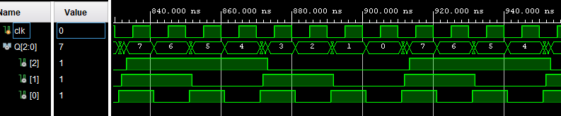
Ripple Counter
This is an example of an asynchronous sequential circuit using toggle flip-flops
Popular in ASIC design, but performs poorly on FPGAs, since normally we don’t use other signals for clock. Too much uncertainty!
module ripple_counter( input clk, output reg [2:0] Q = 0);
// notice sneaky initialiser above needed for simulation
always @ (posedge clk ) Q[0]=!Q[0];
always @ (posedge Q[0]) Q[1]=!Q[1];
always @ (posedge Q[1]) Q[2]=!Q[2];
endmodule
D Q
D Q
D Q
CLK
C Q
C Q
C Q
Q0
Q1
Q2
BEHAVIOURAL SIMULATION
Exercise:
This appears to count backwards what would you change to make it count forwards?
POST ROUTE TIMING SIMULATION
Notes:
Usually, FPGA has a dedicated clock pin.

Slide 95

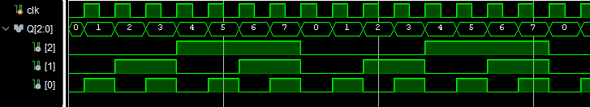
Synchronous version….
D Q
D Q
CE
C Q
D Q CE
C Q
We can still do this with the toggle flip-flops with a single clock
C Q
This is appropriate for an FPGA
Q0
Q1
Q2
CLK
-- VHDL
process(clk) begin
if rising_edge(clk) then
Q(0) <= not Q(0);
if Q(0)=‘0’ then
Q(1) <= not Q(1);
end if;
if (Q(0)=‘0’) and (Q(1)=‘0’) then
Q(2) <= not Q(2);
end if; end if;
end process;
module sync_ripple_counter ( input clk, output reg [2:0] Q = 0);
always @ (posedge clk) begin
Q[0] = !Q[0];
if (!Q[0]) Q[1] = !Q[1];
if (!Q[0] & !Q[1]) Q[2] = !Q[2];
end endmodule

Slide 96
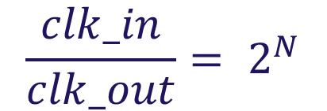
Clock Divider
clkin
Clock
clkout
Divider
We can simply use a counter (half-value) and when it wraps then toggle the output which then forms the divided clock.
The tools will automatically handle all the detail no need to do anything special.
The alternative is to use the CoreGen Wizard to instantiate a clock-tile which contains a PLL and can synthesise clocks radically different from the source crystal even fractional.
module ClkDiv(input clk_in,output clk_out);
reg [32:0] counter = 0;
always @(posedge clk_in)
begin
counter = counter + 1;
end
assign clkout = counter[N];
endmodule
$$\frac{clk_in}{clk_out}= 2^{N}$$
Notes:
板书

Slide 97
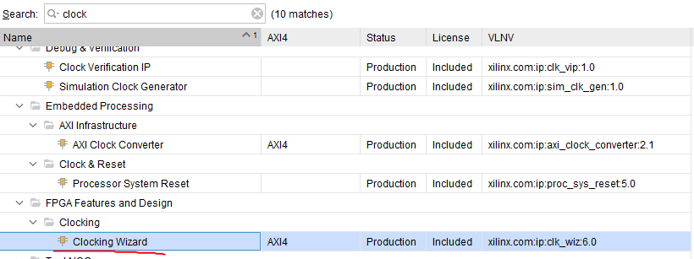
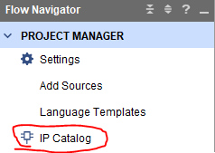
CoreGen Wizard
The alternative is to use the CoreGen Wizard to instantiate a clock-tile which contains a PLL and can synthesise clocks radically different from the source crystal even fractional.
Vivado -> IP Catalog -> clocking Wizard
Notes:
Vivado 演示

Slide 98
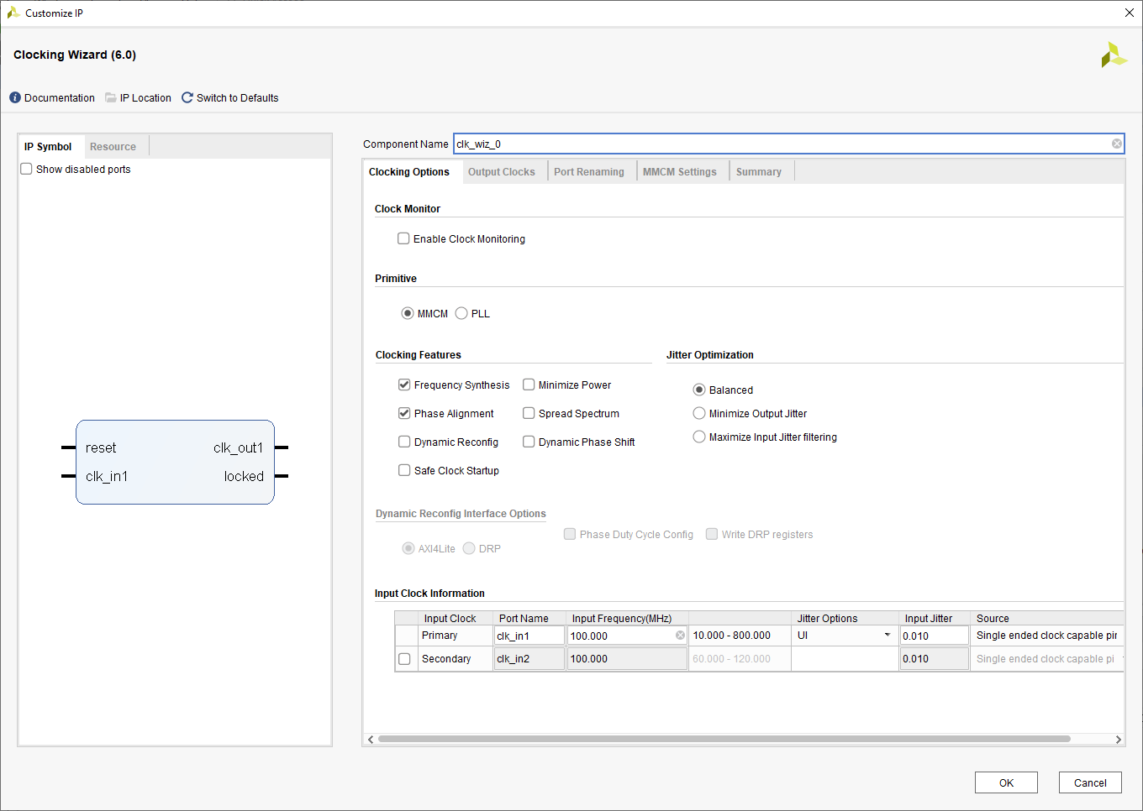

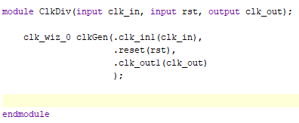
CoreGen Wizard - Vivado

Slide 99
Using an IP in the Design
IP is short for Intellectual Property
It is supplied by the vendors
Users can use them in their design if proper licenses have been purchased.
It is vendor-depended! So if you include an IP in your design. You cannot directly copy your code.
For different vendors, the IP with the same functionality probably have different names.
Xilinx: clock wizard, Altera: PLL (phase lock loop).

Slide 100
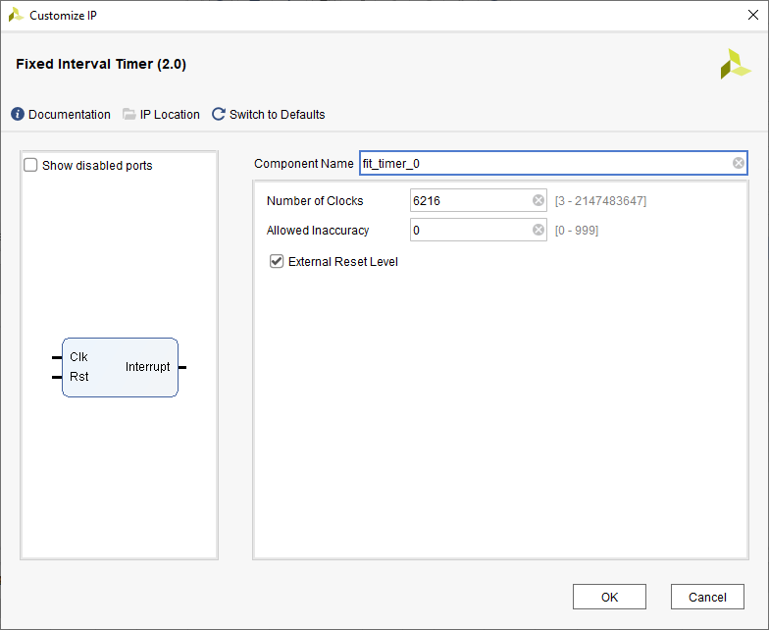
Timer
period
Flexible timer
tick
enable
Lets count down instead of up
Generates a tick pulse at given period
The period updates at end of each tick
Xilinx IP: FLT
clk
module FlexiTimer
# (parameter WIDTH=16)
( input clk,
input [WIDTH-1:0] period,
output tick);
reg count [WIDTH-1:0] = 0;
always @(posedge clk)
if (count==0) begin
count=period; tick=1’b1;
end
else begin
count <= count - 1; tick = 1`b0;
end
endmodule
Notes:
Fix interval timer Vivado 演示

Slide 101
ROM
ROM
addr
dout
The trick with ROM’s is we often have the contents we want somewhere in some format so the problem becomes how to conveniently define this in an HDL. In Verilog we can load the contents conveniently from text files in binary or hexadecimal using the $readmemb or $readmemh
system functions.
// 512 off 20-bit values from hex file
reg [19:0] mydata [0:511];
initial $readmemh(“rom.txt”,mydata); assign dout = mydata[addr];
/* alternative using serialise and concatenation operators */
reg [19:0] mydata [0:511] = {>>{ {
20’h01234, 20’h232f5, …. } }};
assign dout = mydata[addr];
The alternative is to define them as literal initialisation as part of a (constant) array.

Slide 102
RAM
module memory
#( ADDR_BITS=8, DATA_BITS=8 )
( output [DATA_BITS-1:0] dout, input [ADDR_BITS-1:0] addr, input [DATA_BITS-1:0] din, input writeen, input clk );
reg [DATA_BITS-1:0] memory [0:2**ADDR_BITS-1];
always @(posedge clk)
if (writeen) memory[addr] <= din;
assign dout = memory[addr];
endmodule
addr
datain writeen
RAM
dataout
clk
Unlike a ROM it can be written to thus MUST be clocked. The readback can be unclocked or clocked to suit the application.
In this version we have an address, write-enable, datain and dataout.
Formally this is a write-first implementation but FPGA can do alternative read-first and nochange with/without registered output
entity SinglePortRam is
Generic ( N : integer := 8; A : integer := 8 ); -- N=Data width A=address width
Port ( clk, we : in std_logic;
addr : in std_logic_vector(A-1 downto 0); din : in std_logic_vector(N-1 downto 0); dout : out std_logic_vector(N-1 downto 0) );
end SinglePortRam;
architecture Behavioral of SinglePortRam is
type RAM_type is array (0 to 2**A-1) of std_logic_vector(N-1 downto 0);
signal RAM : RAM_type;
begin
process (clk) begin
if rising_edge(clk) then if we='1' then
RAM(conv_integer(addr)) <= din; -- write data
end if;
end if;
end process;
dout <= RAM(conv_integer(addr)); -- read data
end Behavioral;

Slide 103
Dual port RAM
clk1
addr1
din1 we1
addr2
din2
we2
dout1
RAM
dout2
There are various flavours such as twin port ram which has separate read and write addresses.
This allows two simultaneous busses to access the same contents.
To know which you have inferred best to check the synthesis report
Here a true 2-clock dual port ram version and is
described with no-change update rule.
Which type of memory is best depends on your application and available resources.
clk2
module dpram
#( ADDR_BITS=8, DATA_BITS=8 )
( output reg [DATA_BITS-1:0] dout1, input [ADDR_BITS-1:0] addr1, input [DATA_BITS-1:0] din1,
input we1,clk1,
output reg [DATA_BITS-1:0] dout2, input [ADDR_BITS-1:0] addr2, input [DATA_BITS-1:0] din2,
input we2, clk2 );
reg [DATA_BITS-1:0] memory [0:2**ADDR_BITS-1];
always @(posedge clk1)
if (we1) memory[addr1] <= din1;
else dout1 <= memory[addr1];
always @(posedge clk2)
if (we2) memory[addr2] <= din2;
else dout2 <= memory[addr2];
endmodule
Block RAM: Final Mapping Report
+ + +
+ + + + + + + + +
|Module Name | RTL Object | PORT A (Depth x Width) | W | R | PORT B (Depth x Width) | W | R | Ports driving FF | RAMB18 | RAMB36 |
+ + + +
+ +
+
+ +
+
+
+
|
|dpram | memory_reg | 256 x 8(NO_CHANGE) | W | R | 256 x 8(NO_CHANGE)
| W | R | Port A and B
| 1
+
| 0
+ + + + + +
+ + +
+
+

Slide 104
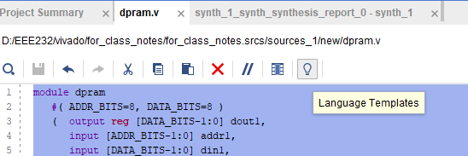
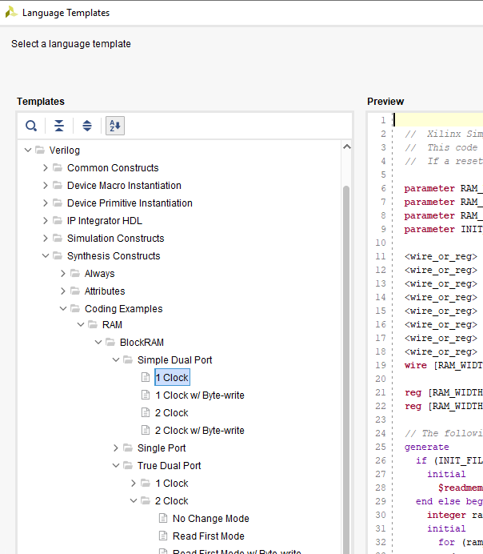
Which type of RAM
To know what kind of memory you have created check the synthesis report
This can be distributed or BLOCK memory and single, twin or dual port
There are many alternatives. Fortunately the built in help will show you how to do this.
From the editor window click on the light bulb, then your language (eg Verilog) followed by Synthesis Constructs then coding examples
This gives you a language template to modify as you need and can save you LOTS OF TIME.
Notes:
Apart from Ips, we also have template!

Slide 105
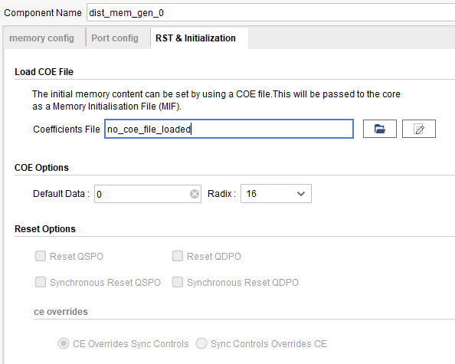
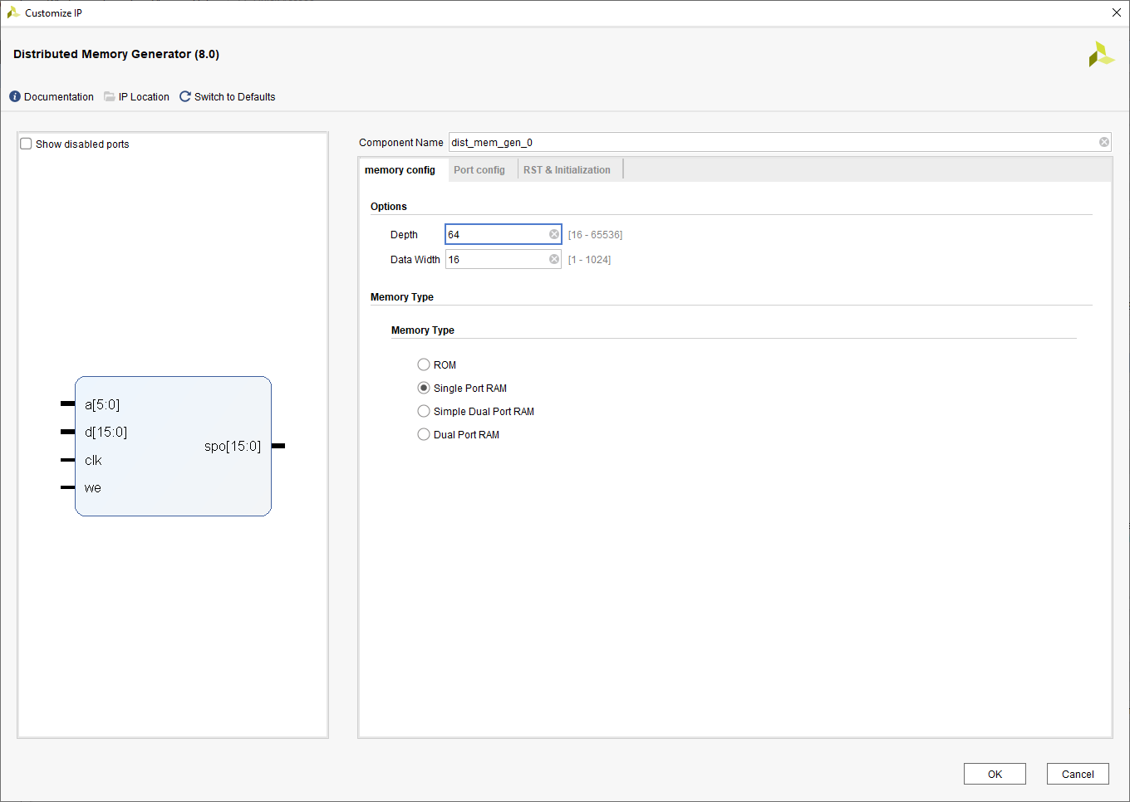
ROM&RAM using IPs

Slide 106
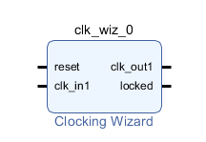
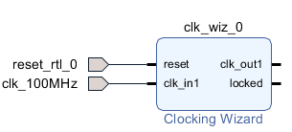
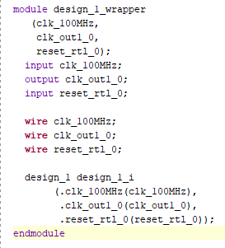
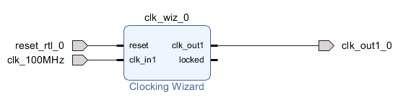
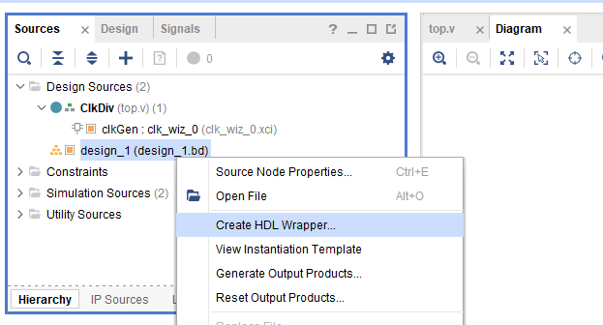
IP Integration – block design
Create block design in the IP INTEGRATOR
Click ADD IP button
Search for Clock Wizard
You will be able to see this
Click Run Connection Automation
You will see that the input has been connected
Then we manually connect the output
Then you can see the generated wrapper
Create HDL Wrapper

Slide 107
Design Choice & Critical Path Mitigation

Slide 108
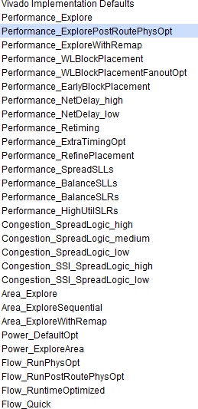
Setting tool strategies
Modern tool offer a large number of options for setting optimisation goals and effort. These at first order prioritise Power, Area or Performance.
The second level is then to resolve typical FPGA issues around routing congestion or to tweak the priority to focus on a more specific part of the overall performance (eg minimise net delays).
You only need to be aware that such options exist and tools do much of the optimisation automatically prioritising power, area or time.

Slide 109
Creating effective constraints
The tools need constraints to operate well, and more recently Xilinx have disabled outputting performance information unless you have defined at least a clock constraint.
Constraints are used to inform the tools of the designers intent. These are in terms of timing, physical area of chip to be used for some module, locking the I/O pin assignments, etc.
Xilinx pull all of the constraints together in a single text file (.XDC). Xilinx Constraint Format is a language to specify all the constraints for a design. It is described in detail later. Other vendors use a similar approach albeit the syntax varies slightly the key concepts are the same.
Over the next few slides the different areas for ‘constraints’ are described.

Slide 110
XDC constraints
# An example XDC file
# constrain clock
set_property -dict {PACKAGE_PIN E3 IOSTANDARD LVCMOS33} [get_ports CLK100MHZ]
create_clock -period 10.000 -name sys_clk_pin
-waveform {0.000 5.000} -add [get_ports CLK100MHZ]
Mostly the timing wizard and IO planner can be used without needing to resort to editing the XDC file directly. (Formally XCF)
But there are exceptions so familiarity with XDC is recommended.
-dict{ } allows specifying more than one
property for either top level.
Searches for matching names for either top level ports (get_ports) or internal nodes (get_pins). Yes, these are confusingly defined (not by me!)
# fix I/O to specific pins and signal levels
set_property -dict {PACKAGE_PIN H17 IOSTANDARD LVCMOS33} [get_ports {LED[0]}] set_property -dict {PACKAGE_PIN K15 IOSTANDARD LVCMOS33} [get_ports {LED[1]}] set_property -dict {PACKAGE_PIN J13 IOSTANDARD LVCMOS33} [get_ports {LED[2]}]
# set output drive strength if needed
set_property DRIVE 4 [get_ports { PWM[*]}];
# allow for specific multicycle paths if needed (here 12 cycle), names from timing report
set_multicycle_path 12 -setup -from [get_pins {slider/areg[*]/C}]
-to [get_pins {slider/breg[*]/D}]
set_multicycle_path 11 -hold -from [get_pins {slider/areg[*]/C}]
-to [get_pins {slider/breg[*]/D}]
Vivado Constraints Guide:
https://www.xilinx.com/support/documentation/sw_manuals/xilinx2018_3/ug903-vivado-using-constraints.pdf

Slide 111
Critical path mitigation
In many designs there will be a very few areas of the design which have relatively slow paths. If unchecked this forms the critical path and thus sets the maximum possible clock rate for the design.
There are a number of options available to fix these paths:
Register balancing/duplication (retiming) – if enabled this is done automatically by the tools by moving ‘slow’ functions either side of registers or adding duplicate registers to break excessive fan out. However, there needs to be sufficient registers / cycles in the datapath for the tool to have freedom to operate. It wont change the overall number of cycles in the datapath.
Multi-cycle paths – if the result of some combinatorial logic isn’t required in the next clock cycle after its input was defined, the designer can tell the tool which cycle it is required by thus it has multiple-clock cycles to stabilise to its final (valid) value before being clocked in.

Slide 112


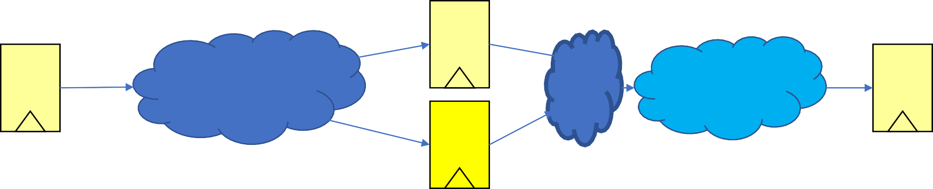
Register Balancing Example
Original clock period
Original clock period
To do this enable
–retiming in the synthesis options
Shorter Retimed clock period
Shorter retimed clock period

Slide 113
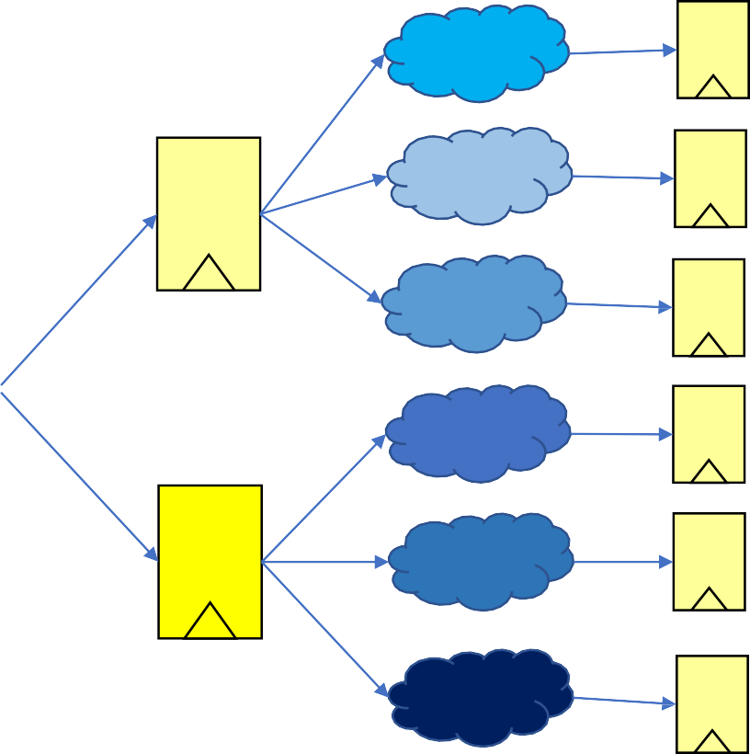
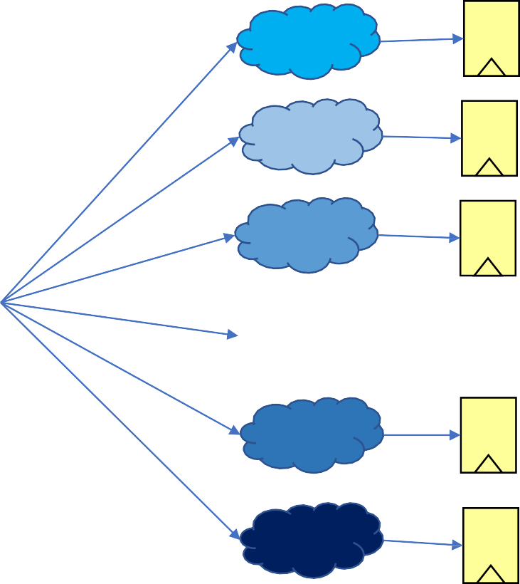
Register Duplication Example
Each Combi Logic is say 20fF load
Total 60fF
Each DFF
Total 120fF
To do this enable
–retiming in the
synthesis options
PATH LOGIC DELAY
Shorter retimed clock period
PATH DELAY
LOGIC DELAY

Slide 114





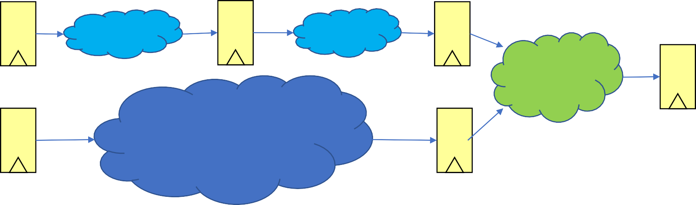
Multi Cycle Path Example
result
used
Slow complicated function that cant be split easily
Original Period set
by slow operation
Original Period set by slow operation
Original Period set by slow operation
Retimed Period
Retimed Period
result used
This is done by adding a set_multicycle_path statement in the XDC file
Slow complicated function evaluates over two cycles
Retimed Period
PATH CONSTRAINT ALLOWING TWO CYCLES

Slide 115

Floor planning
With large designs the execution time for the tool to carry out the placement and routing would be excessive as it is a NP hard problem.
We simply this by breaking down our design along its hierarchy by setting area constraints on various modules so the P&R has a set of much simpler problems to solve.
In Vivado open the implemented design, then from the netlist window
choose a module within your design and “floorplan” then “Create P block”.
You can then draw a rectangle to constrain the locations for this module.

Slide 116
Vivado Constraints Wizard
This tool (under synthesis menu) will help the designer describe the complete set of timing constraints for their design and pick up any which are missing. It will create the XDC for you ☺
Although, it is still up to the designer to put in correct / valid
information. Don’t guess, please refer to external component datasheets
where needed.
This is particularly important when internally multiplying up an external crystal fed clock to a higher frequency, otherwise the PLL in the FPGA can go unstable with unexpected clock jitter.

Slide 117
Evaluate your Design

Slide 118


Power Performance Area (PPA)
When evaluate a piece of hardware, we usually see if we have a good PPA trade-off.
Power – Can be found in Open Implemented Design -> Report Power
Area – Can be found in Open Implemented Design -> Report Ultilization
Performance – This is bit tricky
Throughput & Latency
You need to find out the max clock frequency you can have by finding out the time of covering the critical path. For example, if the critical path takes at least 20ns, you obviously cannot use 10ns (100MHz) clock frequency but have to use 50MHz
To find out this, a post Simulation is always recommended as it takes all the physical conditions into the simulation.
Then you will be able to know how many outputs you have within 1 second if you keep feeding inputs. This is called the throughput.
The time you wait from your first input to the first output, is called the latency

Slide 119

Power Performance Area (PPA)
Based on the requirements of the application or your design goal, it’s always good to know if the following 2 factors meets the design specs.
Performance/Area Efficiency – How much speed you have within 1 LUT
Performance/Power Efficiency – How much speed you have within 1 W
If we look at a publication in the top journal, you will know the commonly used evaluation points
Latency
Area
Power
Throughput
Energy Efficiency
Area Efficiency
Max Frequency

Slide 120
Algorithmic improvements
The tools don’t do this – yet – or likely in the near future so us engineers are still in a job for a while ;-)
Need to quickly assess how a candidate design performs vs our
customer’s design constraints
Assess different alternatives and supply the best one
Ultimately the decision is an economic one: time to market,
customer needs, design team costs, managing risk, etc…
Typically the designer is comparing performing the required operations sequentially over a number of cycles with a datapath versus performance gains from using more area / parallel operation

Slide 121



Algorithmic Trade offs
Set of simpler operations performed sequentially, some are repeated
The unrolled baseline version of the design. All operations wired together one after each other. Slowest and large area
Unrolled
C
A
B B
B
control
If possible write a generalised datapath to do operations, here B&C iterate over a number of cycles, here 4 to give required result. Low area moderate speed
Iterative
A
Generalised operation
4 cycles: B B B C
Look at redefining operator to break dependency so operations can be done in parallel. Example shows redefined B’ in parallel. The design can then be further pipelined or iterated.
B’
A
∑
C
Parallel
B’
Pipelined
Registers between operations allowing shorter clock period and higher throughput with new data every clock cycle. Improves throughput at expense of latency
A
B
B
B
C

